Slide 1
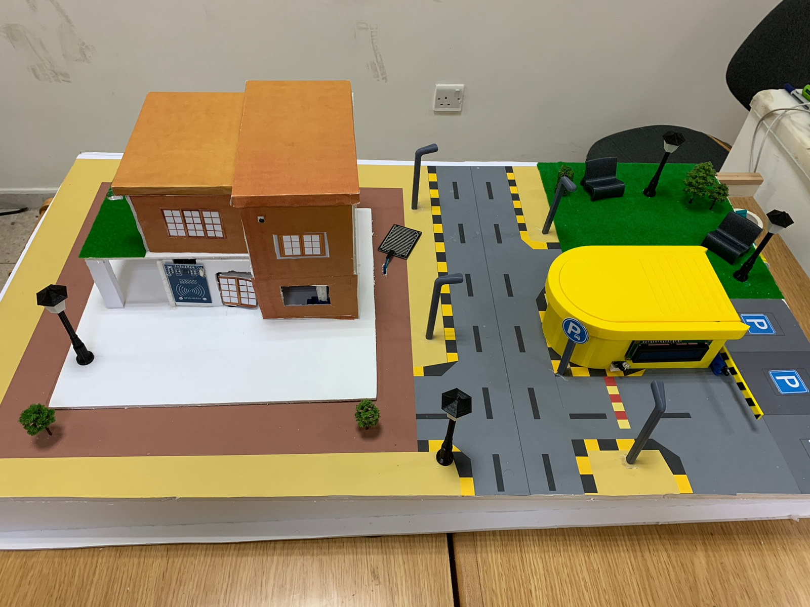
Smart home project

Slide 2
01
Introduction

Slide 3
Our project is a smart home prototype that provides security and safety features that people need these days, many sensors have been used to offer convenience and safety

Slide 4
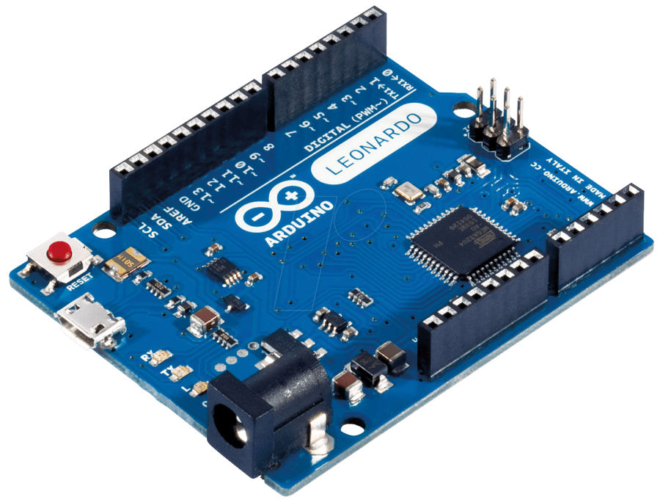
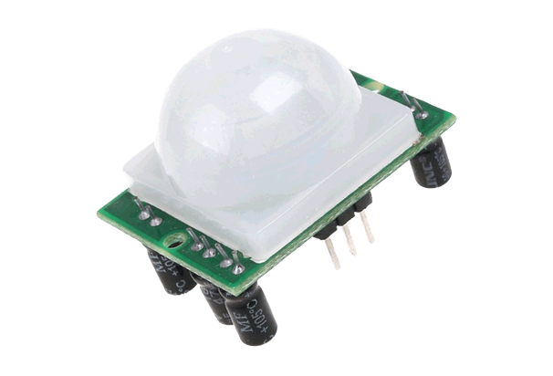
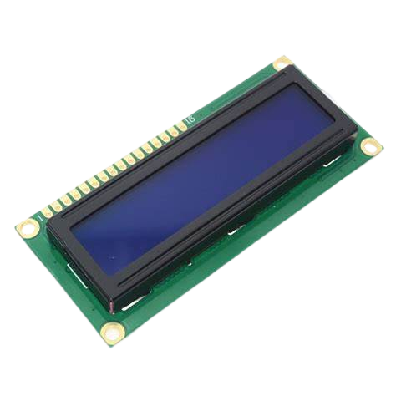
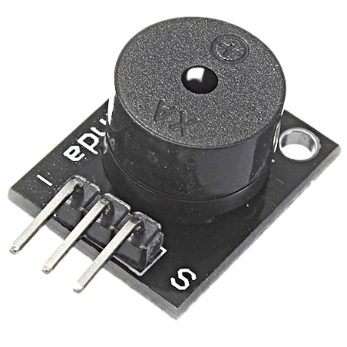
02
Project Hardware

Slide 5
Arduino Leonardo
The Arduino Leonardo is a microcontroller board based on the ATmega32u4. It has 20 digital input/output pins (of which 7 can be used as PWM outputs and 12 as analog inputs), a 16 MHz crystal oscillator, a micro-USB connection, a power jack, an ICSP header, and a reset button.

Slide 6
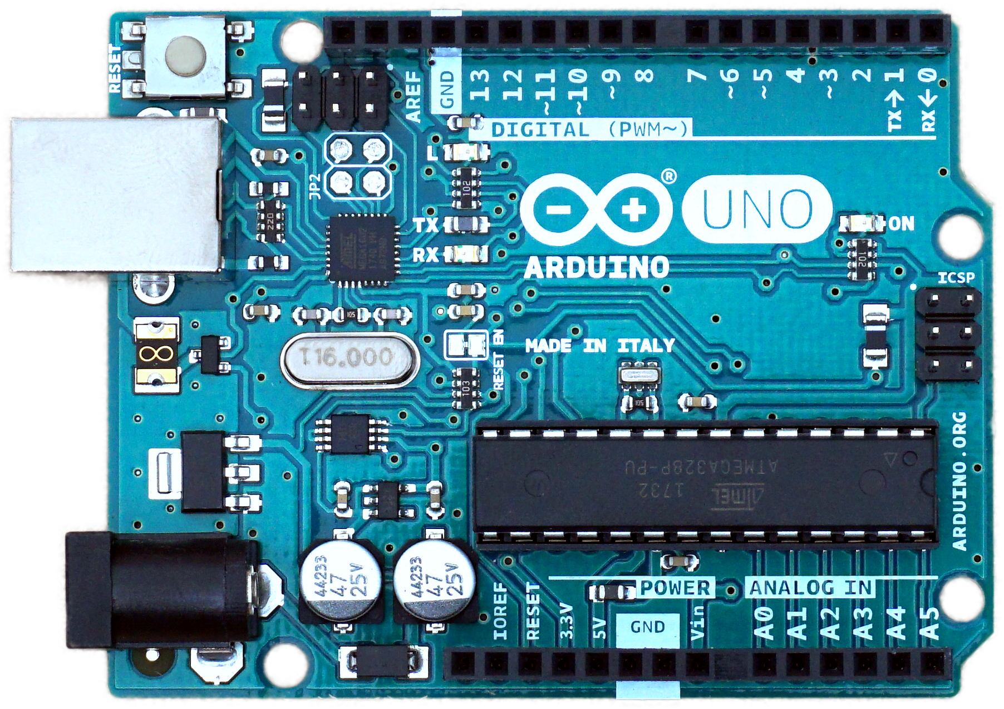
Arduino UNO
The Arduino Uno is an open-source microcontroller board based on the Microchip ATmega328P microcontroller. The board is equipped with sets of digital and analog input/output (I/O) pins that may be interfaced to various expansion boards (shields) and other circuits.

Slide 7
PIR Sensor
A PIR is a passive infrared sensor used to detect motion, so a PIR is a passive motion detector that waits for infrared temperature from body heat to trigger an activity. In other words, it can sense motion through changes in temperature.

Slide 8
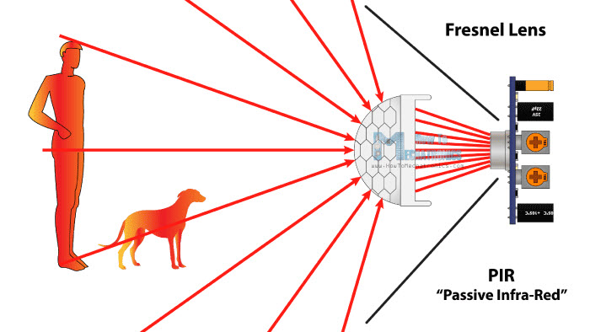
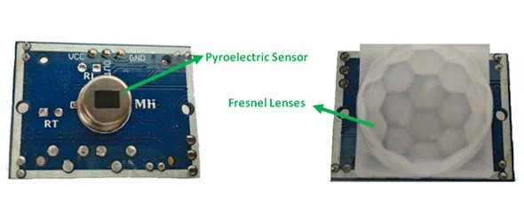
How it work?

Slide 9
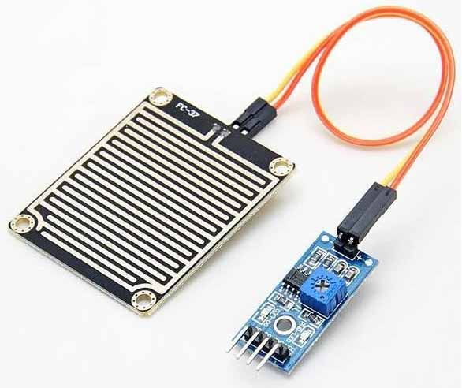
Rain Sensor
This sensor detects the rain and gives an alert to concerned persons in different fields like irrigation, automobile communication, home automation, etc.

Slide 10
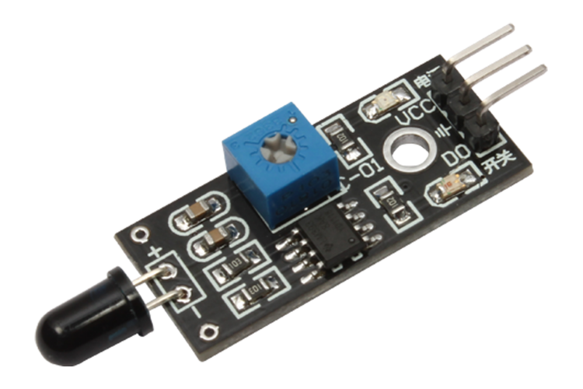
Flame Sensor
A flame-sensor is one kind of detector which is mainly designed for detecting as well as responding to the occurrence of a fire or flame. The flame detection response can depend on its fitting. The response of these sensors is faster as well as more accurate compare with a heat/smoke detector because of its mechanism while detecting the flame.

Slide 11
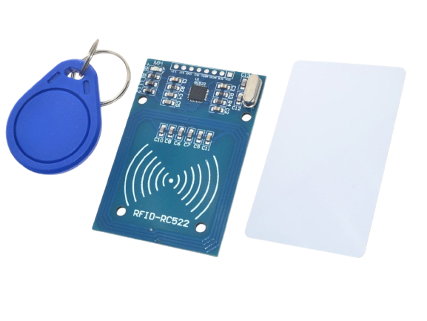
RFID
RFID is an acronym for “radio-frequency identification” and refers to a technology whereby digital data encoded in RFID tags or smart labels (defined below) are captured by a reader via radio waves.

Slide 12
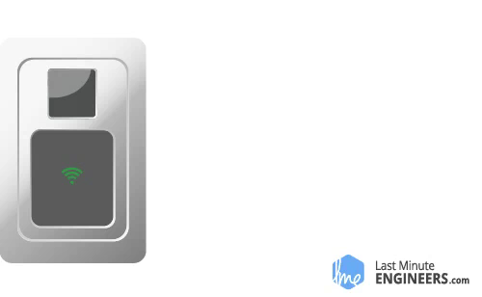

Slide 13
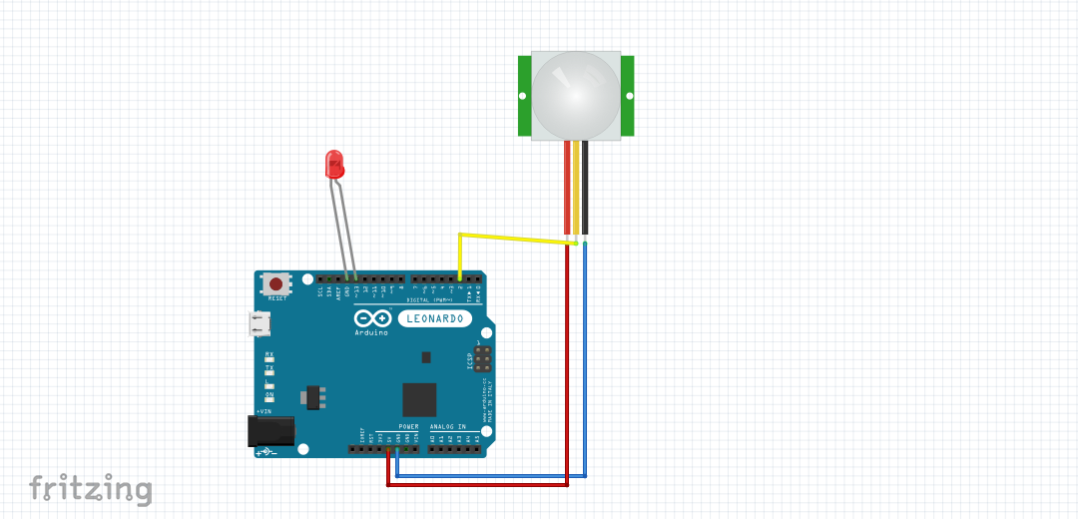

Slide 14
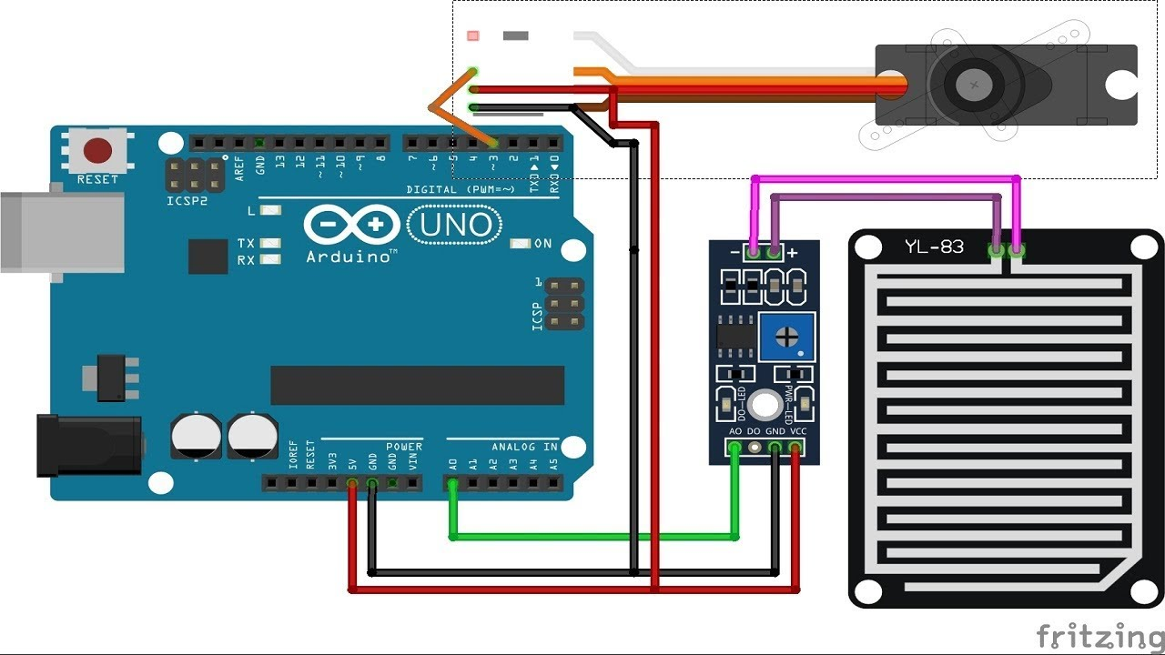

Slide 15
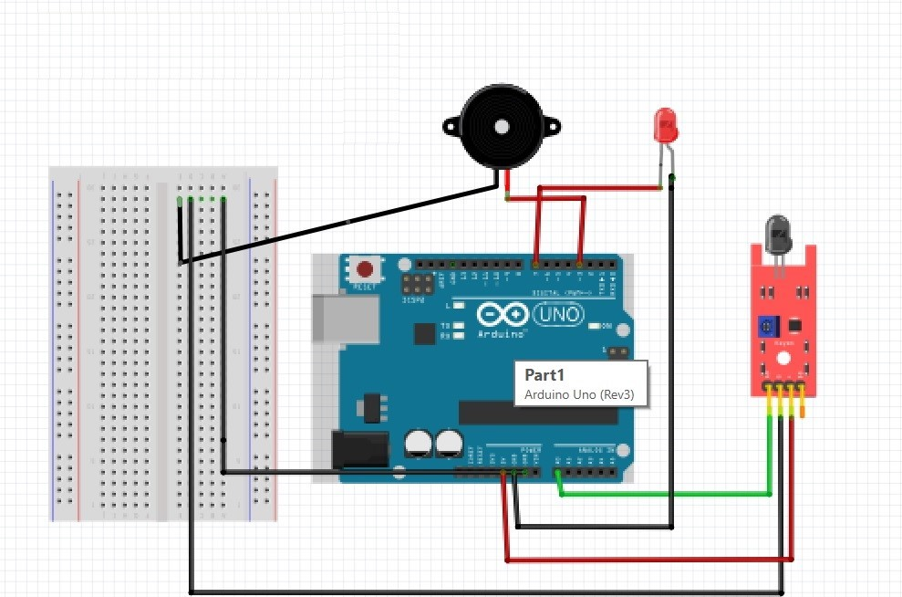

Slide 16
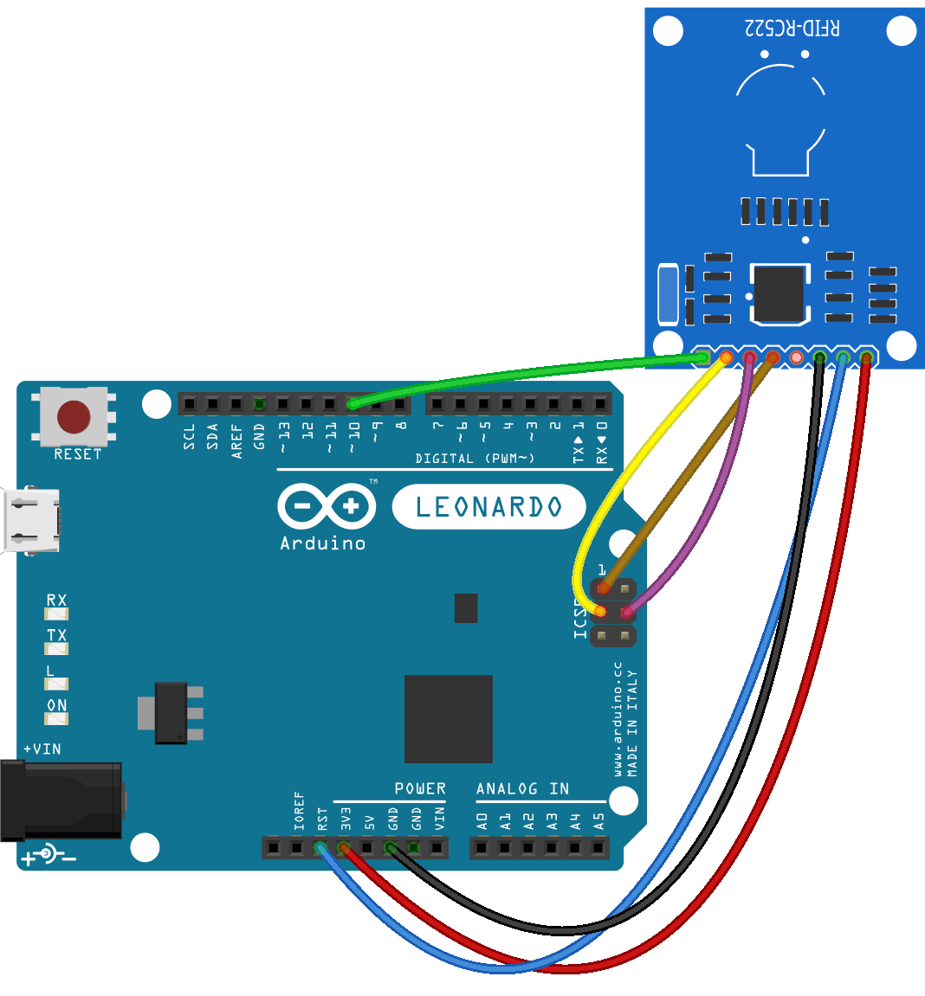

Slide 17
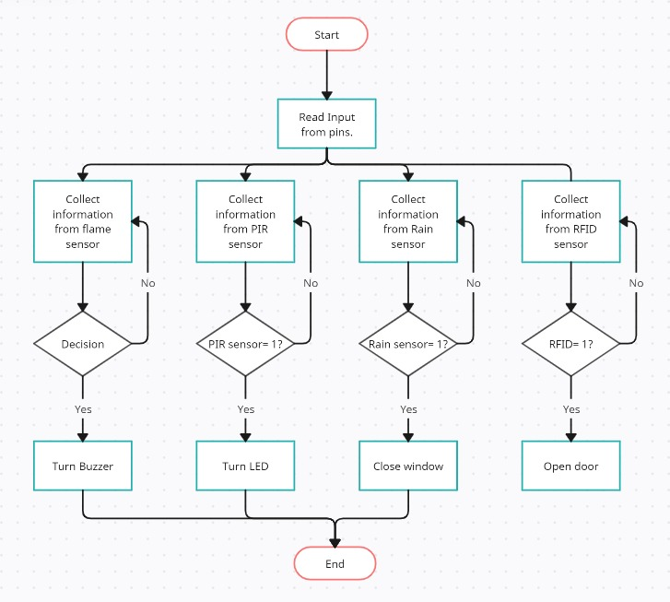

Slide 18
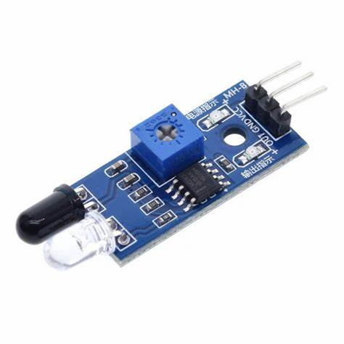
IR-Infrared sensor
Infrared Sensor is most used sensor in wireless technology where remote controlling functions and detection of surrounding objects/ obstacles are involved.

Slide 19
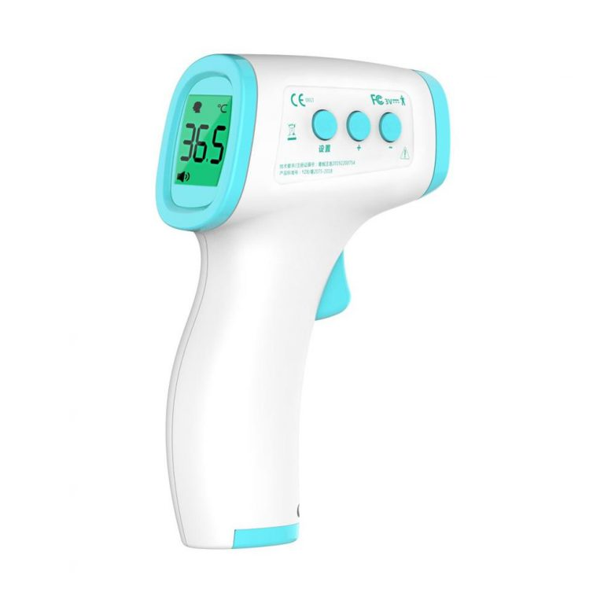
Example of
IR sensor:

Slide 20
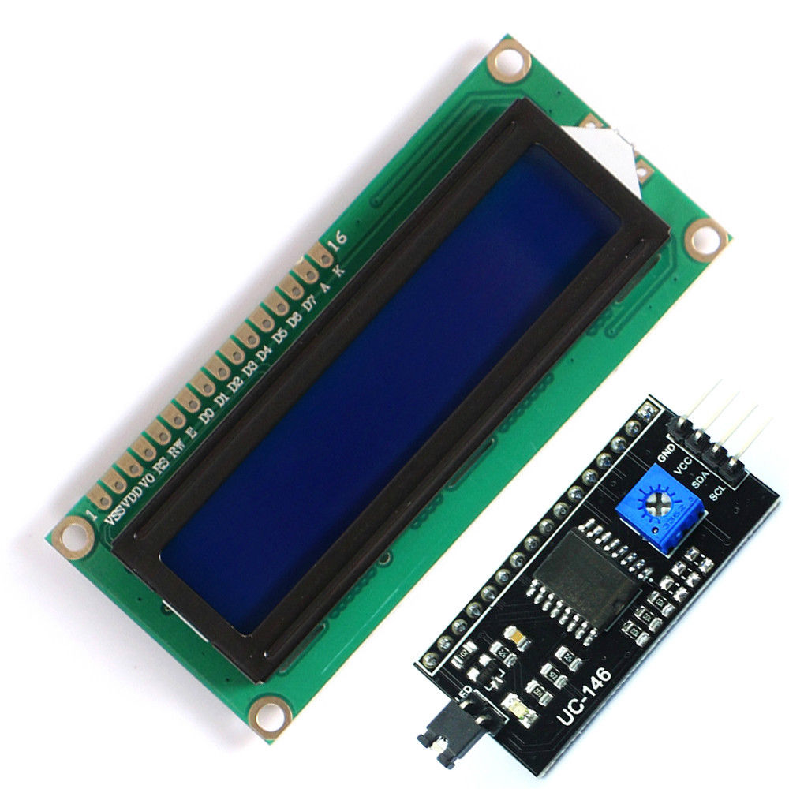
Liquid Crystal Display (LCD)
16x2 LCD modules are very commonly used in most embedded projects, the reason being its cheap price, availability, programmer friendly and available educational resources.

Slide 21
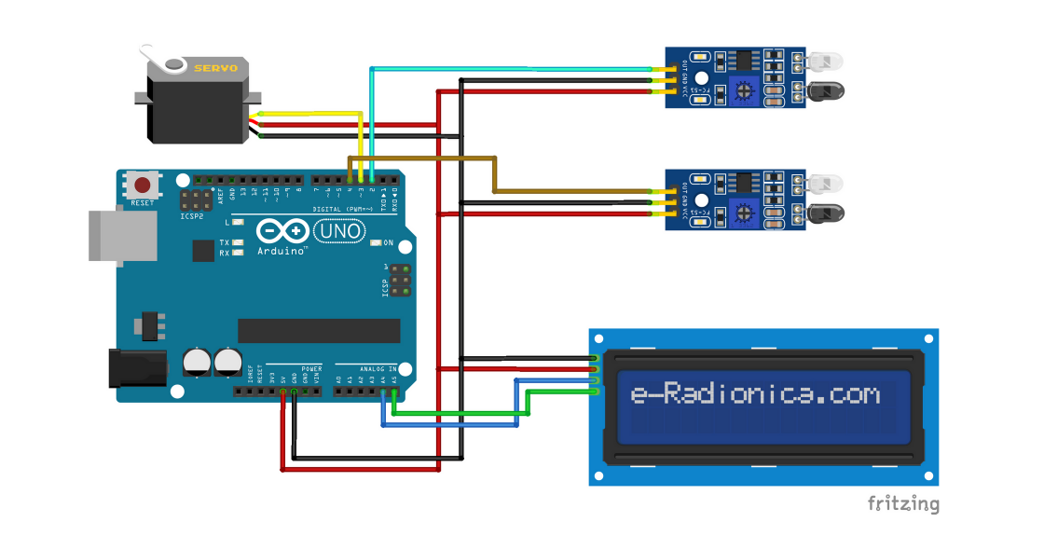

Slide 22
3
Project code

Slide 23
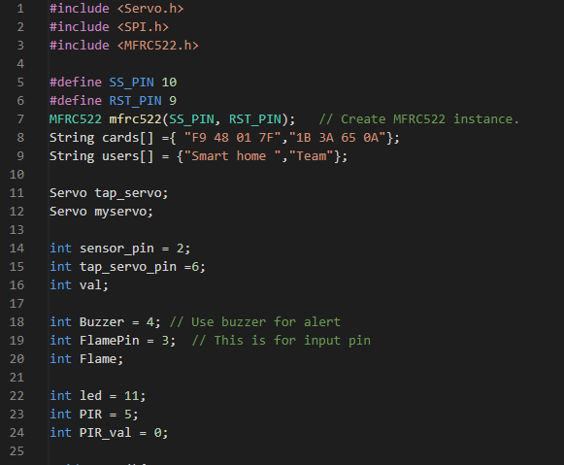
Smart home code

Slide 24
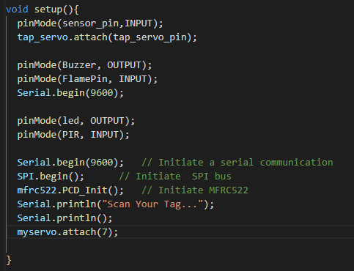
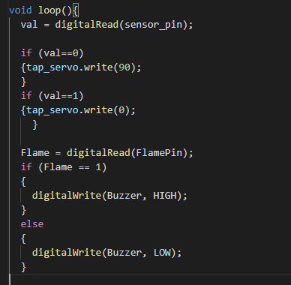
Continue …

Slide 25
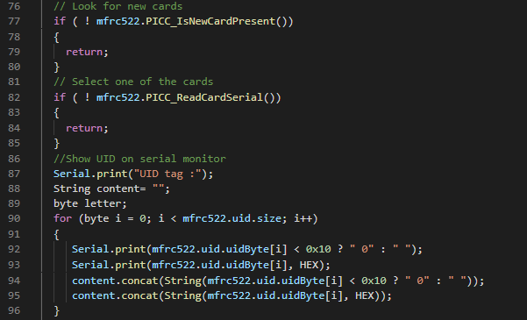
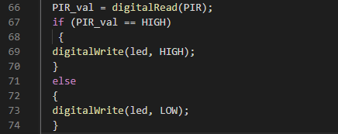
Continue …

Slide 26
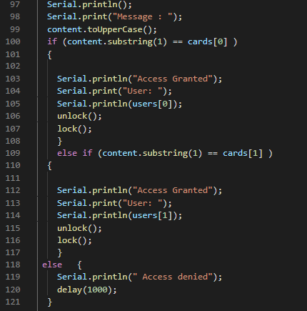

Continue …

Slide 27
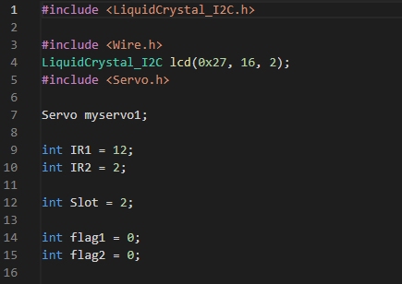
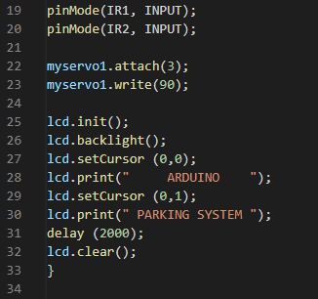
Car parking system code

Slide 28
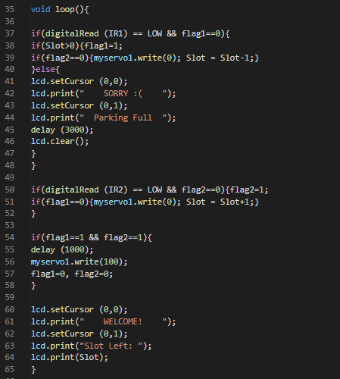
Continue …

Slide 29
Abdallah Nader || 0206921
Ahmad Abu-Diak || 0207744
Hasan Fuad || 0207670
Osama Awad || 0206505
Ahmad Riyad || 0202679
Mohammad Ali ||0207684
Mmohammad AlNajjar || 0207904
Thank You ..!

Slide 30
